Slide 1

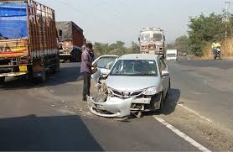
Accident Locations on Indian Roads
(Data collection & mapping)
Sreenidhi Institute Science and Technology
B.Tech – CSE-AI&ML
Institute Mentor :
Dr T V Rajini Kanth
Professor and Head, CSE AI&ML
Presented by :
Team : (404_Found)
M.Pavan
K.Revanth
Himanshu Parida
Mentor by Intel :

Slide 2
Introduction
India ranks first in the world for the number of accidents and lives lost on the roads. The country has only 1% of the vehicles in the world but has 11% of the accidents in the world. Ministry of Road Transport (MoRTH) uses the concept of a Black Spot https://morth.nic.in/ black-spot to mark these locations to improve road safety on national highways in the country.

Slide 3
Abstract
Understanding the location of road accidents is crucial for effective road safety planning and intervention strategies. This presentation focuses on analyzing accident locations on Indian roads and identifying high-risk areas. The presentation begins with an overview of road accident statistics in India, emphasizing the magnitude of the problem and its social and economic impact. Factors contributing to accidents, including human factors, road infrastructure, and vehicle-related issues, are discussed. The importance of analyzing accident locations is highlighted, as it enables the identification of high-risk areas and targeted interventions. The presentation covers data sources and collection methods, including national and state-level accident databases, police reports, and hospital records. Spatial analysis techniques such as GIS mapping, cluster analysis, kernel density estimation, and heatmaps are explained as tools to identify accident hotspots.

Slide 4
Road Accident Statistics in India
One serious road accident in the country occurs every minute and 16 die on Indian roads every hour.
1214 road crashes occur every day in India.
Two wheelers account for 25% of total road crash deaths.
20 children under the age of 14 die every day due to road crashes in in the country.
377 people die every day, equivalent to a jumbo jet crashing every day.
Two people die every hour in Uttar Pradesh – State with maximum number of road crash deaths.
Tamil Nadu is the state with the maximum number of road crash injuries

Slide 5
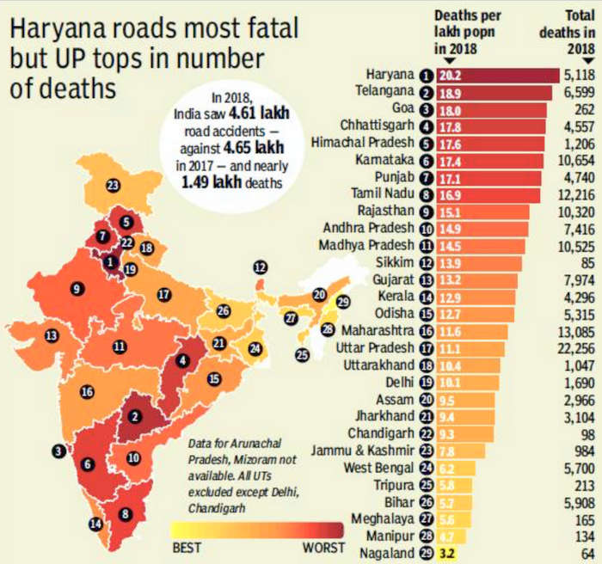

Slide 6
Importance of Analyzing Accident Locations
Helps identify high-risk areas and implement targeted interventions.
Provides insights for road infrastructure improvements.
Enables efficient allocation of resources for law enforcement and emergency services.

Slide 7
Data sources and collection
The data is collected from the official website of government .
Here are some links related to data collection :
https://data.gov.in/resources
https://visualize.data.gov.in/
https://community.data.gov.in/state-ut-wise-cases-of-road-accidents-during-2020/

Slide 8
Data Analysis and visualization Techniques
Geographic Information System (GIS) mapping.
Using Python and it’s Libraries.

Slide 9
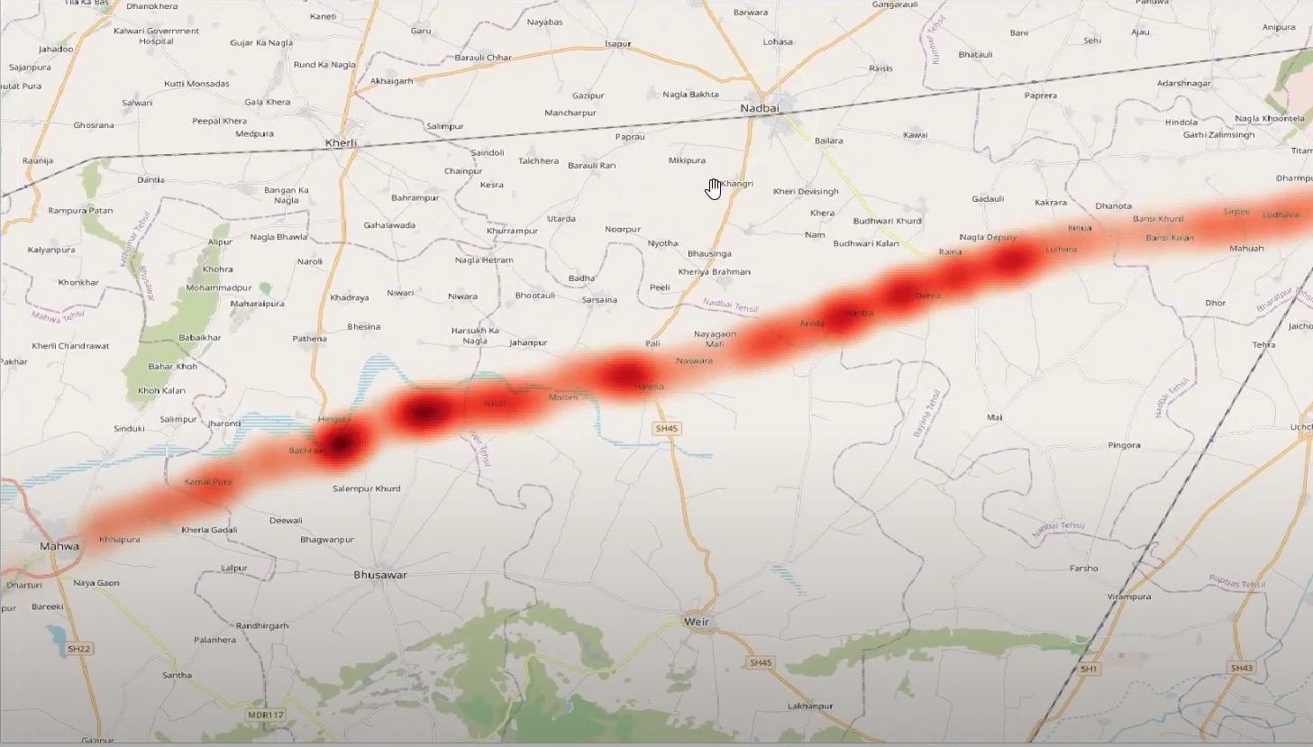
Geographic Information System (GIS) mapping.
GIS mapping involves the collection, storage, analysis, and visualization of geographic data using specialized software. It enables users to organize, interpret, and understand complex data within a spatial context.

Slide 10
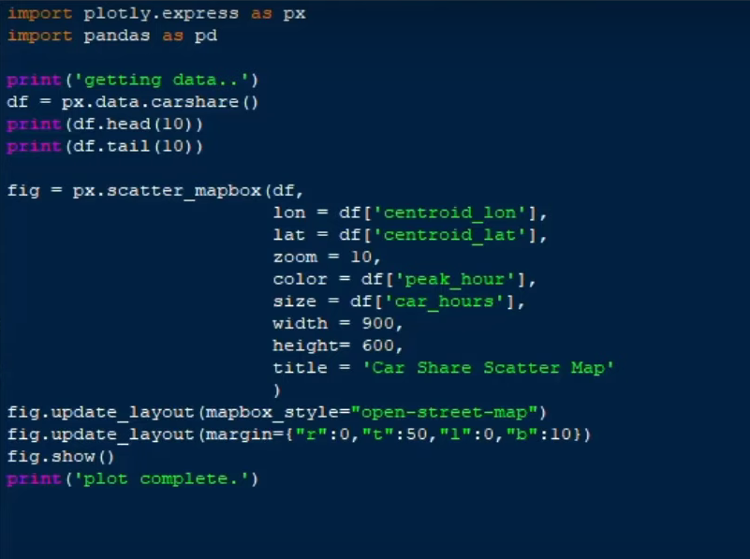
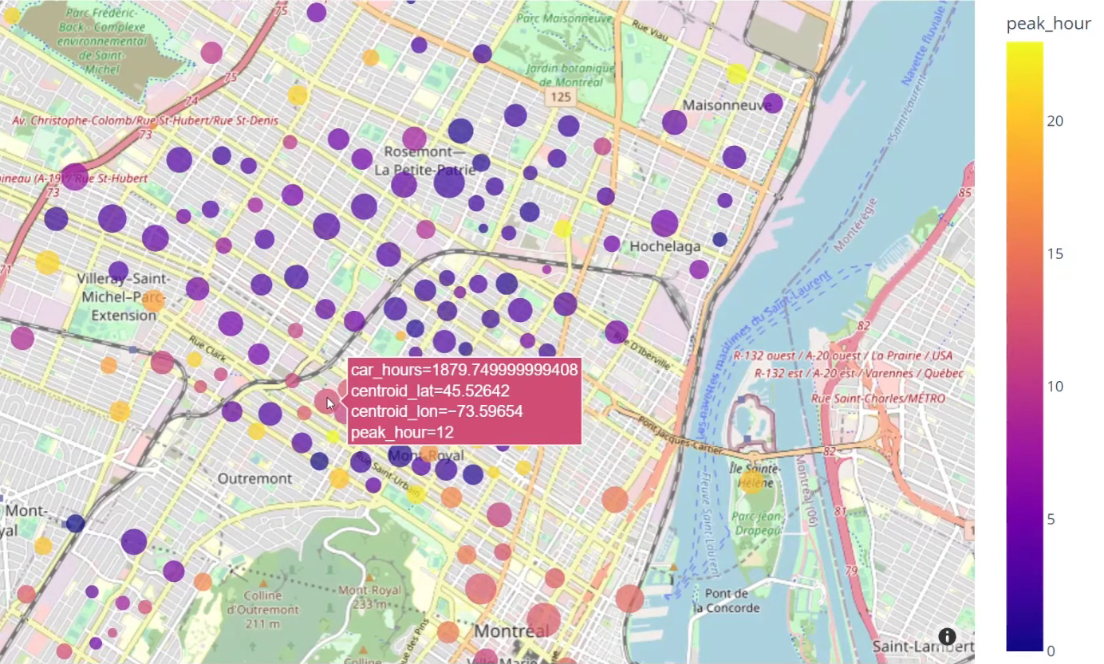
By using Python and it’s Libraries
Libraries used :
Plotly.express (used for data visualization)
Pandas (used for data manipulation)

Slide 11
References
https://data.gov.in/resources
https://visualize.data.gov.in/
https://community.data.gov.in/state-ut-wise-cases-of-road-accidents-during-2020/
https://morth.nic.in/
https://www.indiatoday.in/india/story/deaths-india-road-accidents-data-infographic-1959819-2022-06-08
https://timesofindia.indiatimes.com/india/this-is-what-makes-indian-roads-deadliest/articleshow/78870630.cms

Slide 12
Thank you

Slide 13
Acknowledgement
Thank you, Mr. Narayana Babu, for your invaluable assistance and guidance throughout the duration of this project.
We express our sincere gratitude to the Government of India for graciously providing the essential dataset that was instrumental in the successful completion of this project. Their valuable contribution greatly enriched our research and analysis.

